Slide 1
Gun Violence in the United States of America
(murder dataset)

Slide 2
Table of contents.
load dataset.
Exploratory Data Analysis.
Data Visualization.
Exploring Categorical data.
Visualizing Categorical data.
Bivariate Analysis.
Insights.
Simple linear regression model.
Anova
Prediction

Slide 3
LOAD DATASET
The first step is to load the dataset and assign the dataset to the object data1.
library(dslabs)
data("murders") data1 <- murders

Slide 4
EXPLORATORY DATA ANALYSIS(EDA).
The data frame consists of 51 observations and five variables(features).
State feature is a character, region is a factor while population and total are numeric features.
we note that the minimum value of the total is 2 while the average is 184, which is sensitive to outliers.

Slide 5
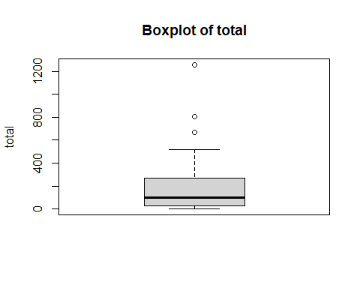
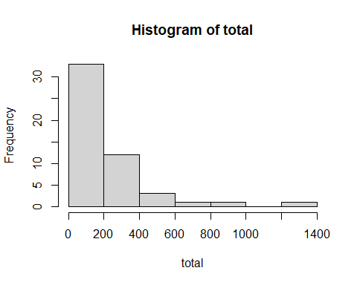
DATA VISUALIZATION.

Slide 6
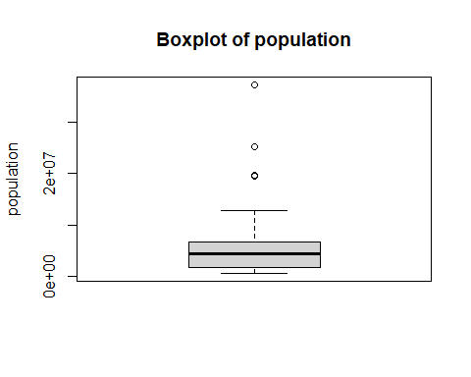
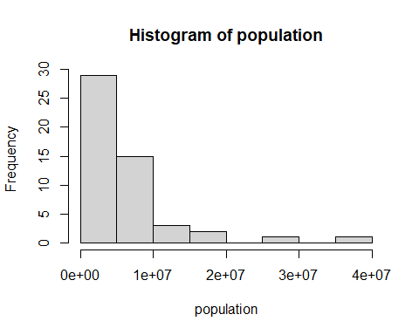
POPULATION VISUALIZATION.

Slide 7
EXPLORING CATEGORICAL DATA
table(data1$state), We note that the mode of the state features is one throughout the column..
table(data1$region), the southern region has the highest mode while the Northeast has the least mode.Northeast(9),South(17),North Central(12),West(13).
## ## Northeast South North Central West ## 9 17 12 13

Slide 8
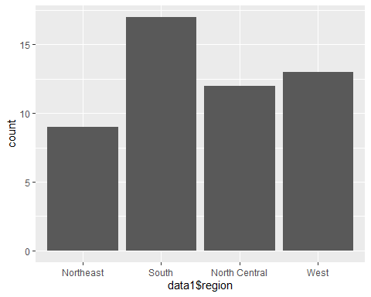
VISUALIZING CATEGORICAL DATA.
After visualizing a region feature we note that the south region has the highest bar count.

Slide 9
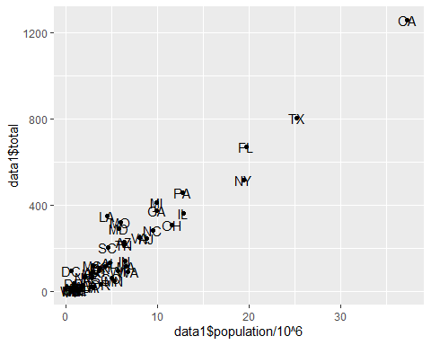
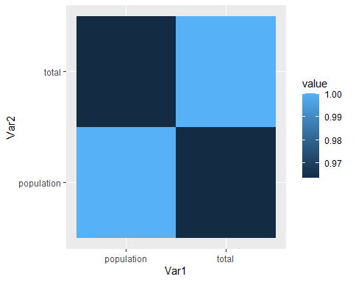
BIVARIATE ANALYSIS

Slide 10
INSIGHTS
From the visualization(scatterplot and heatmap),we note that there’s a correlation between the population of each estate and the total number of deaths in each estate.
cor(data1$population/10^6, data1$total)
## [1] 0.9635956
there is a high positive correlation between them since the correlation between them will be closer to 1

Slide 11
SIMPLE LINEAR REGRESSION MODEL
simple_lm <- lm(total~population, data1) simple_lm
## ## Call: ## lm(formula = total ~ population, data = data1) ## ## Coefficients: ## (Intercept) population ## -1.713e+01 3.316e-05

Slide 12
ANOVA
Contains the sums of squares, degrees of freedom, F statistic, and p value.
anova(simple_lm)
## Analysis of Variance Table ## ## Response: total ## Df Sum Sq Mean Sq F value Pr(>F) ## population 1 2588498 2588498 636.47 < 2.2e-16 *** ## Residuals 49 199280 4067 ## --- ## Signif. codes: 0 '***' 0.001 '**' 0.01 '*' 0.05 '.' 0.1 ' ' 1

Slide 13
PREDICTION
pred1 <- predict(simple_lm, data1)
We predict the the number of deaths based on the population of each state.

